Slide 1

Oracle JET Talent Launch April 2018 Jeroen Rijnboutt & Laura Broekstra

Slide 2
Oracle JET

Slide 3
Facts
Oracle JET announced on OOW 2015
Open Source Release (v2.0.0) February 2016
Version 3 - March 2017
Version 4 - September 2017
Version 5 - April 2018

Slide 4
What is JET?
JET is an JavaScript Extensible Toolkit.
Not to be confused with a framework.
Oracle chooses open-source modularity over a framework with EOL.
What is a toolkit?
Collection of proven (adult) libraries.
Together they provide all needed functionality.

Slide 5
Advantages toolkit
Easier to add other libraries.
Easier to throw out libraries and choose different solution.
Easy for Oracle to change configuration of toolkit in later versions.
Good documentation for separate libraries

Slide 6
Disadvantages toolkit
Not the most modern. (No TypeScript, ES6)
Possible faster EOL for older versions
No concise documentation

Slide 7
What is in the toolkit?
RequireJS – Lazy-loading of modules
KnockoutJS – Databinding
jQuery
Cordova – Mobile applications

Slide 8
Oracle JET and AMIS
Darling - begin 2017 (POC)
Follow-up Darling – october 2017
IHC – summer 2017 (2 small portals)
Follow-up IHC – november 2017 (1 big portal)
Grown to 5 developers (+2 architects)

Slide 9
Agenda – Day 1
General JET
First installation
Refreshing our JavaScript
RequireJS
KnockoutJS
Lunch
JET Cookbook
Working with REST
JET Common Model

Slide 10
Agenda – Day 2
Finish assignments day 1
Visualization components
Layout
Lunch
JET architecture
Composite Components

Slide 11
Installing JET
JET current version 4.2.0
Get Started page: http://www.oracle.com/webfolder/technetwork/jet/globalGetStarted.html
Install Oracle JET CLI from NPM
npm -g install @oracle/ojet-cli
ojet create <applicationName>
Optional: Use a template:
ojet create <applicationName> --template=navdrawer

Slide 12
JET templates
http://www.oracle.com/webfolder/technetwork/jet/globalExamples.html
Basic Starter – no navigation
Nav Bar Starter – a navigation bar
Nav Drawer Starter – a navigation drawer

Slide 13
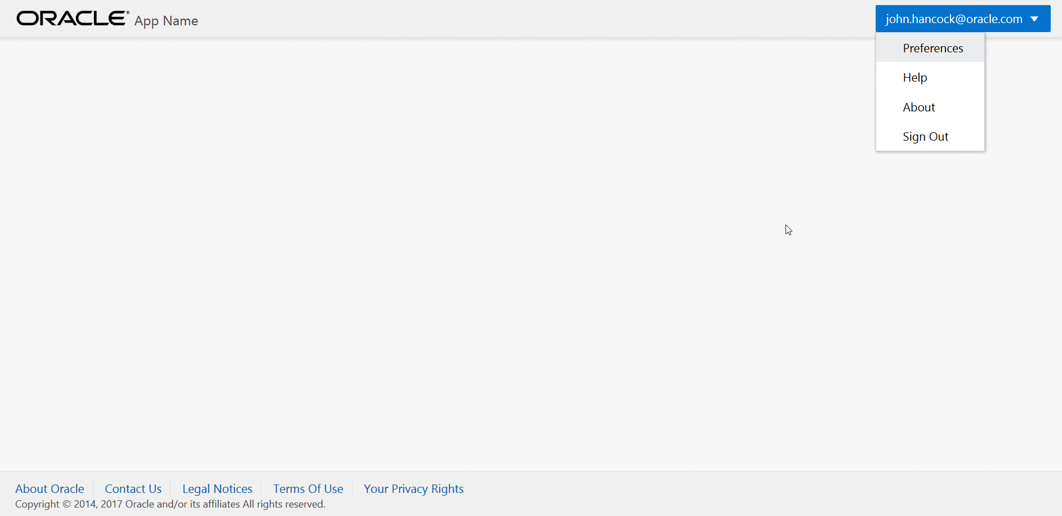
Basic starter

Slide 14
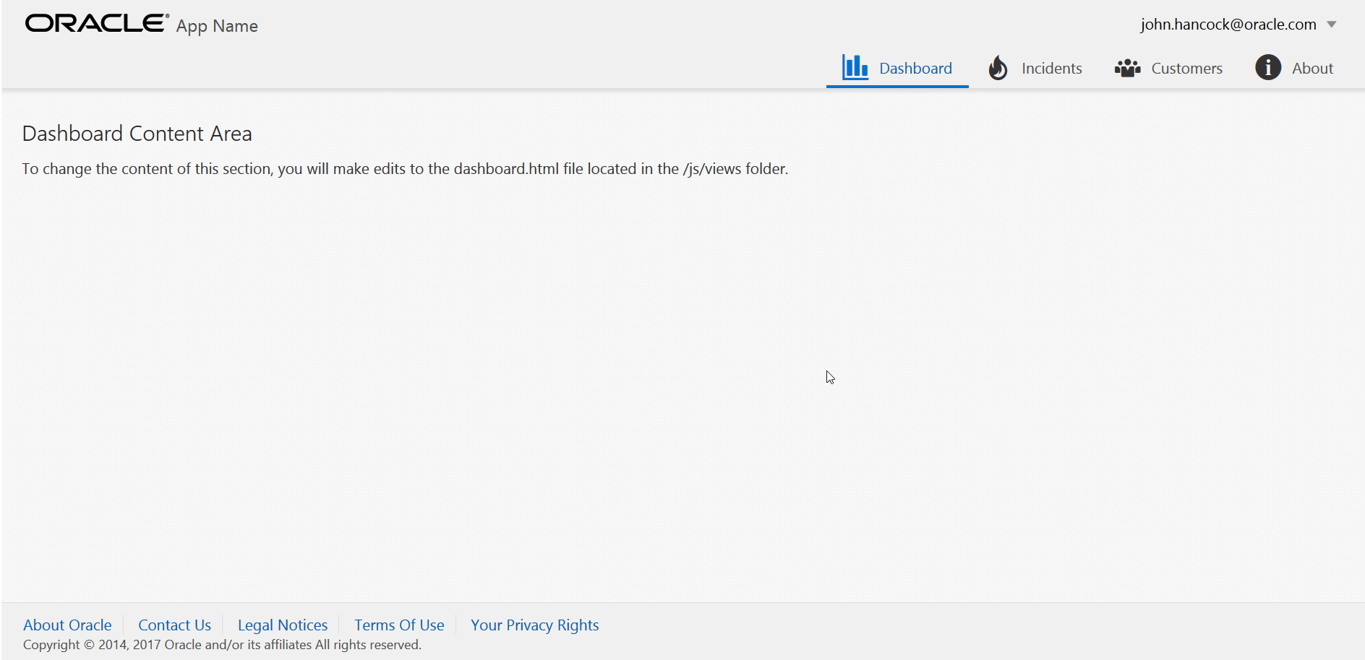
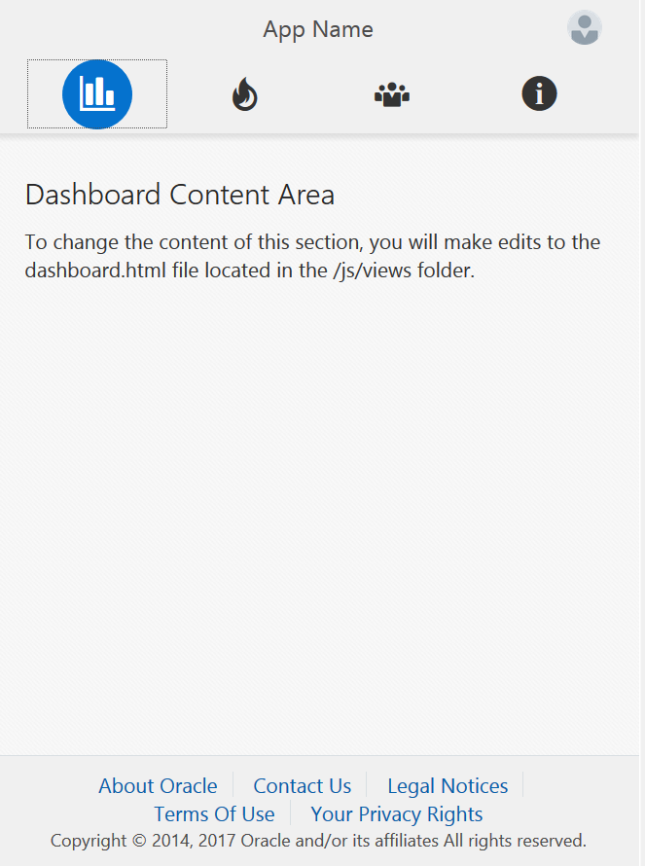
Navbar

Slide 15
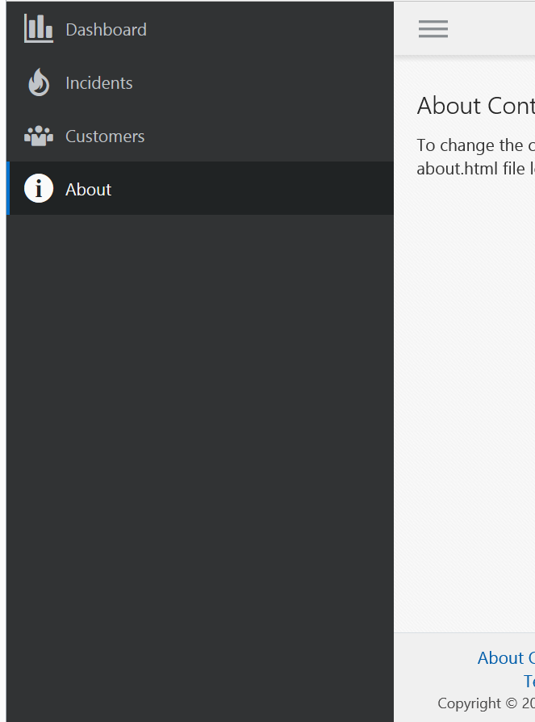
Navdrawer

Slide 16
DIY JET Installation

Slide 17
JavaScript Refresher

Slide 18
JavaScript refresh
Presentation JavaScript
Differences / Similarities Java
Notes:
Because half of the learners in the training know little JavaScript but do know Java. Can be skipped.

Slide 19
jQuery

Slide 20
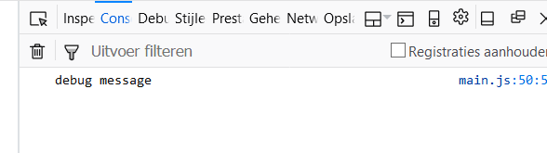
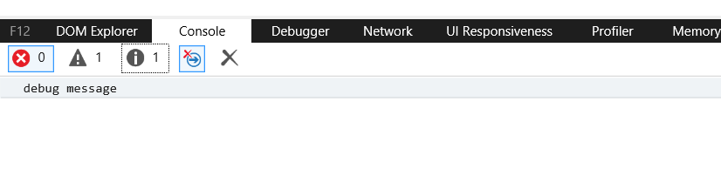
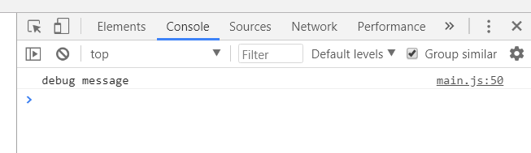
JavaScript debugging
Console.log
console.log(‘debug message’);
Also Objects, Arrays, etc.
Debugging / developer tools available in all browsers (F12)

Slide 21
JET logging
Standard JET logger: ojLogger
Different default log levels: ERROR, WARN, LOG, INFO, NONE
Write a logline:
oj.Logger.warn("Beware of bugs in the above code");
By default only log errors will show in the console
Set the loglevel manually in code or console
oj.Logger.option("level", oj.Logger.LEVEL_WARN);

Slide 22
Require & Knockout

Slide 23
RequireJS
Week 1 - part 2: https://www.youtube.com/watch?v=yznhGmE9VEg
Week 1 - part 3: https://www.youtube.com/watch?v=it9EvsNEPMw

Slide 24
KnockoutJS
Library for databinding
Good tutorials: http://knockoutjs.com/
Start with: Introduction & Working with lists and collections

Slide 25
Observable Arrays
Declare the array:
var niceArray = new ObservableArray([“String1”, “String2”]);
Add a new item:
niceArray.push(“String3”);
Remove last item:
niceArray.pop();
Remove specific item:
niceArray.remove(“String2”);
Read more in documentation: http://knockoutjs.com/documentation/observableArrays.html

Slide 26
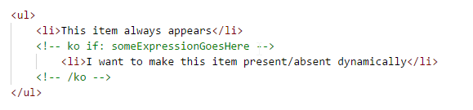
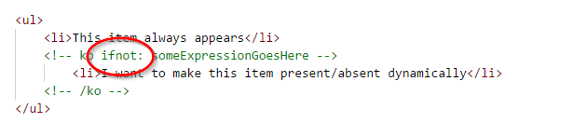
Ko if and if not
Easy way to dynamically show and hide divs in your view
Use comment syntax:

Slide 27
New databinding syntax since JET 4.0
Oracle takes a small step towards Angular
<span data-bind="text: id"></span>
<span data-bind="text: name"></span>
Becomes:
<p>{{id}} {{name}}</p>
This is two-way databinding (write changes back to observable)
One-way binding (no write-back) goes like this:
<p>[[id]] [[name]]</p>

Slide 28
DIY Knockout

Slide 29
JET Cookbook

Slide 30

JET Cookbook
JET Components
Shows all available JET components
Code examples
Adjust and test code in browser
JS Doc
Notes:
Short demo of JET Cookbook, show different categories
Short demo of how to include component in code

Slide 31
JET Cookbook
Checklist
Use HTML
Use JavaScript
Include component in define-block
Notes:
Checklist to remember when using components from cookbook

Slide 32
DIY JET Cookbook

Slide 33
REST

Slide 34
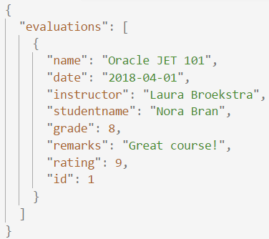
REST
REST
JSON
REpresentational State Transfer
Acces web services
HTTP calls (GET / POST / DELETE / ..)
Call with URL
Response code
JSON output
JavaScript Object Notation
Easy to use for humans and computers
Name/value pairs
List of values
Notes:
Explain the different types of requests in short
Further explain the JSON-format: what are the pairs?

Slide 35
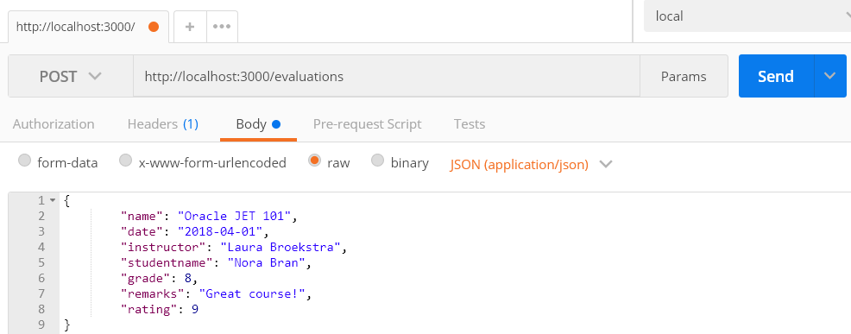
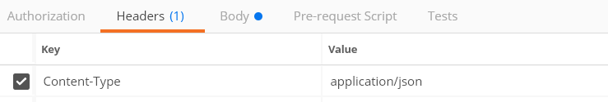
REST
POST(man)
POST-request to save data
Test requests with Postman
Notes:
Showing Postman here as it is a good tool to have in your toolbox.
It is enough to know the basics of request and request body.
But also possible to add headers (in case of this request necessary)
Authorization added
Testing.

Slide 36
REST
JSON-(mock)server
JSON-file
localhost:
3000
App
Exposes data
Request
Notes:
For the assignments in this course we will use json-server as an easy way to get and post data

Slide 37
DIY JSON Server & POST

Slide 38
Common Model

Slide 39
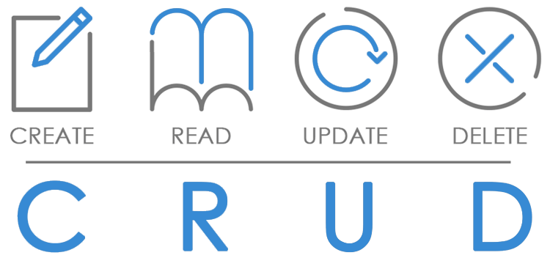
Common Model
Framework
Perform operations on data in backend
Add headers and customize request-URL
Format data for JET collection components
Standard methods to apply to data (get, filter, metadata, transform)
Notes:
Methods to apply: get a specific record, filter the data, get indexnumbers and fetchsizes, transform data to JSON

Slide 40
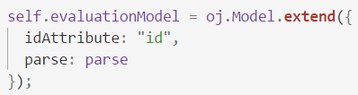
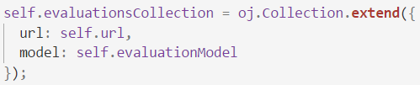
Common Model
Model
Collection
Tabel
Record
Record
Record
Record

Slide 41
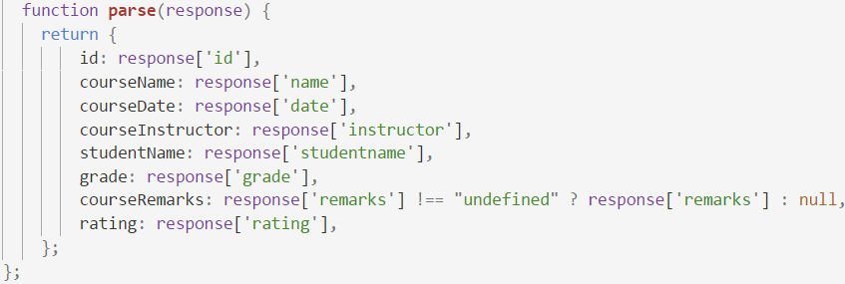
Common Model
REST
GET
JSON
Parse to easy to use object

Slide 42
Common Model
Datasource
Representation of data usable by components
CollectionTableDataSource can be used by Table
Notes:
Can depend on representation of data (collection or array) and the jet component

Slide 43
DIY Collection & Table

Slide 44
End of Oracle JET Day 1

Slide 45
Recap Day 1

Slide 46
Recap day 1
What is JET?
First application
JavaScript refresher
RequireJS
KnockoutJS
Cookbook
REST
Common Model

Slide 47
Program day 2
Finish excercises day 1
Visualization components
Layout
Application architecture
Composite Component
Create your own Component!
Wrap-up

Slide 48
Visualisations

Slide 49
Visualization Components
JET provides numerous nice components in the Cookbook
One of the key features of Oracle JET
Required data structure can be complex
We start easy: Bar Chart
Extra excercises for more complexity
Use the JSdocs! A lot is not used in the cookbook
We user RequireJS text plugin

Slide 50
Excercise notes
Required data structure can be complex
We start easy: Bar Chart
Extra excercises for more complexity
Use the JSdocs! A lot is not used in the cookbook
We user RequireJS text plugin

Slide 51
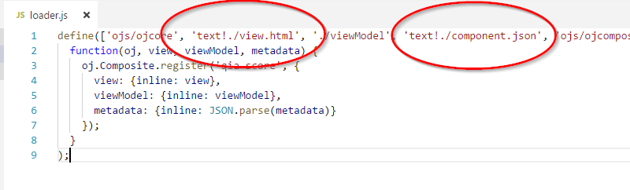
RequireJS text plugin
Standard part of JET
Used for inserting non-JavaScript files
Used in alle Composite Components:

Slide 52
DIY Chart

Slide 53
Layout

Slide 54
Layout
Flexbox
Responsive
flex-container (oj-flex)
(oj-)flex-item
(oj-)flex-item
(oj-)flex-item

Slide 55
Layout
Flex-direction: row (default)
Flex-direction: column
Main Axis
Cross Axis
Cross Axis
Flexcontainer
Main Axis
Flexcontainer

Slide 56
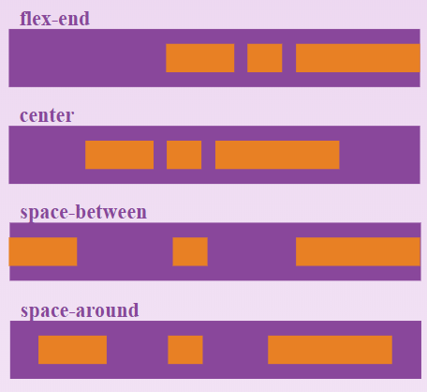
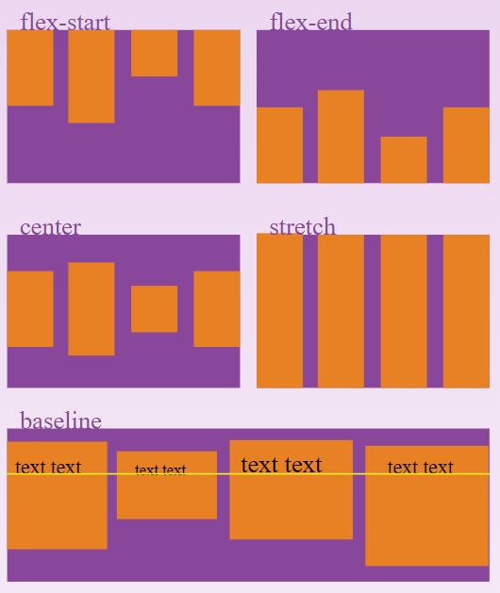
Layout
Alignment
Justify-content: align items along Main Axis
Flex-end
Center
Space-around
Space-between
Align-items: align items along Cross Axis
Center
Flex-start
Flex-end
Baseline

Slide 57
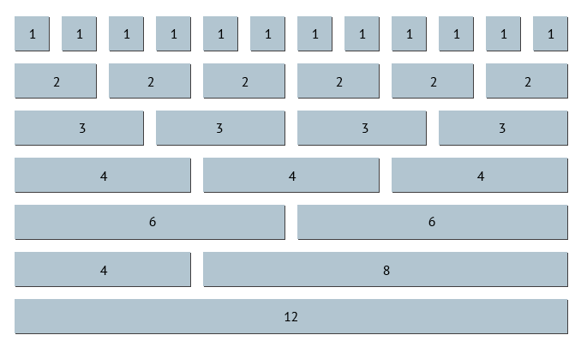
Layout
12 column Grid
Notes:
JET also uses the 12 column Grid layout where the parent element is divided in 12 equal columns.
You can set a child element to be a certain amount (width) of columns in order to make sure some elements are shown on the same row (or not).

Slide 58
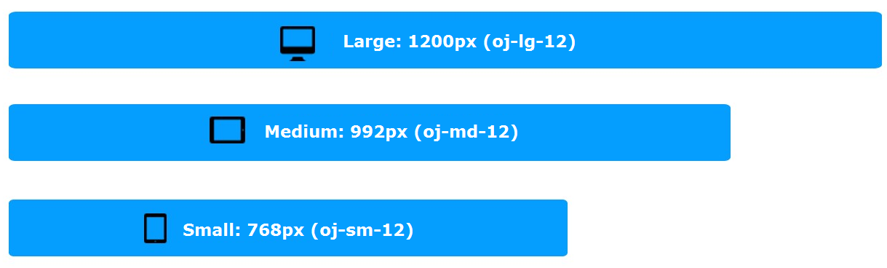
Layout
Responsive sizing

Slide 59
DIY Flex Layout

Slide 60
Architecture

Slide 61
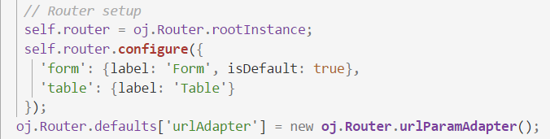
Architecture
Routing
Module navigation
Router state
Store information on router

Slide 62
Architecture
ojModule
Composite Component
“Manages content replacement”
Used by router for navigation
“Reusable piece of UI”
Has own html / JS / CSS
Works on it’s own or with input from parent-application
Clean codebase

Slide 63
Architecture
Verder nog?
Al iets over MVVM in eerste stuk?
https://docs.oracle.com/middleware/jet410/jet/developer/GUID-293CB342-196F-4FC3-AE69-D1226A025FBB.htm#JETDG113

Slide 64
Composite Component

Slide 65
Composite Components
What is it?
Encapsulated piece of functionality
Why use it?
Decreases size of files
Ready to distribute
Ready for re-use

Slide 66
Structure
HTML file (view)
JavaScript file (viewModel)
Loader file (starting point)
JSON configuration file (parameters)
CSS file (styling)
Plaatje structuur CC

Slide 67
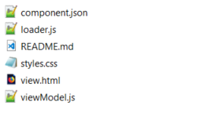
Creating your component
ojet create component <component-name>
ojet create component first-component

Slide 68
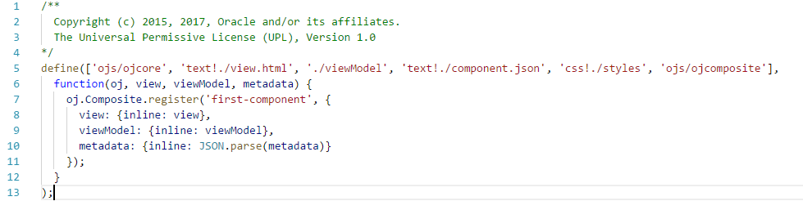
Loader.js

Slide 69
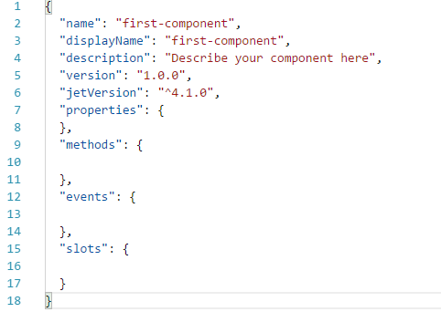
Component.json

Slide 70
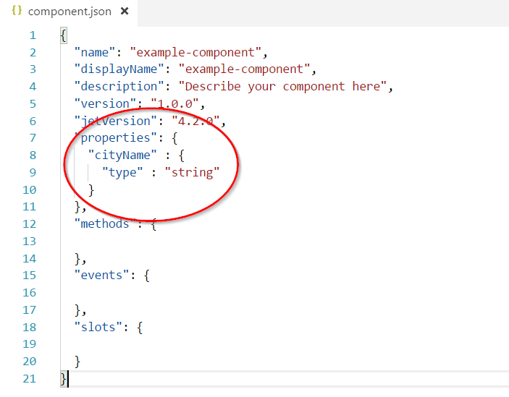
Example

Slide 71
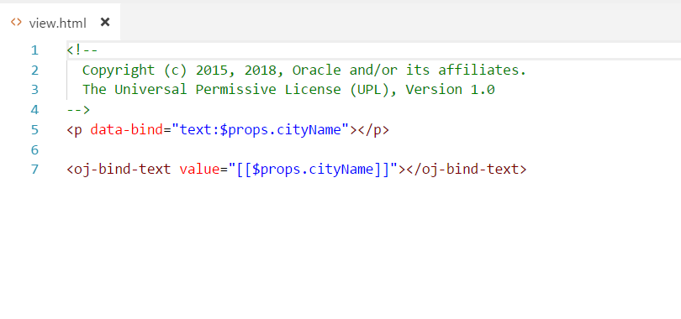
Example

Slide 72
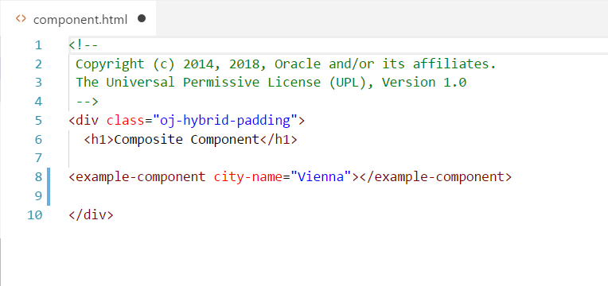
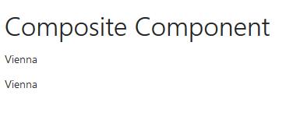
Example
Camel-case property names are converted into case-insensitive HTML element attributes with hyphens at the camel-case break point of the original name.

Slide 73
Excercise notes
Simple component for use in VBCS training
Expand on this with extra excercises

Slide 74
DIY Composite Component

Slide 75
Recap

Slide 76
Wrap-up
Thank you!
Short introduction into Oracle JET
Strenghts (and weaknesses)
Position in the JavaScript landscape
Oracle JET and AMIS

Slide 77
Sources
http://www.oracle.com
http://knockoutjs.com
https://github.com/nklasens/amis-course-2018.git (Nico Klasens, Lucas Jellema)

Slide 78

Feedback

Slide 79
DIY Extra
SIG Lucas Jellema JET and OpenLayers
https://github.com/lucasjellema/sig-meetup-jet-openlayers-composite-components.git
Other Knockout tutorials
http://knockoutjs.com
jQuery tutorials
https://www.w3schools.com/jquery/default.asp
http://jqfundamentals.com/chapter/jquery-basics

Slide 80
End of Oracle JET Day 2

